Slide 1

Submodule Pain - or - How I Learned to Stop Worrying and Love the Subtree
Jackson Oursland

Slide 2
git Submodules
git submodules are a means of pointing to an external repository.
Submodules have a few components:
.gitmodules entry with the remote repo URL and path to check out
.git/modules/ directory which stores the .git of the module
reference in the index and objects which points to the SHA of the commit to be checked out
Note that the files themselves are NOT tracked, only the commit reference which is typically a SHA.

Slide 3
Reference Repositories
oursland/submodule-pain
Top-level repo
oursland/submodule-pain-module
Submodule

Slide 4
PRs Take One: Branches
oursland/submodule-pain-module
PR#1: Branch ‘a’ adds the file ‘a’
PR#2: Branch ‘b’ adds the file ‘b’
There are no possible conflicts
oursland/submodule-pain
Branch ‘master’
81b3d609d3158822a6a37966436f5c64e1eb4ac6 module (heads/master)
PR#1: Branch ‘a’ updates the submodule at branch ‘a’
c7c5d8c0d28bade1ba45706bf49d85df57771947 module (heads/a)
PR#2: Branch ‘b’ updates the submodule at branch ‘b’
75b743cf403b92c8f631d419490f04eef9832d1b module (heads/b)

Slide 5
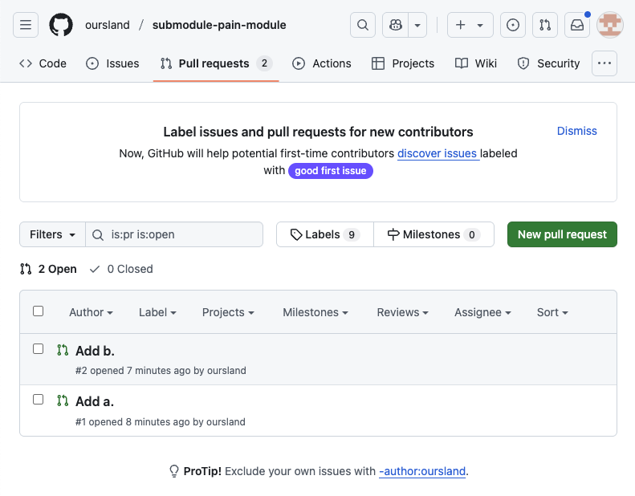
Submodule repo PRs

Slide 6
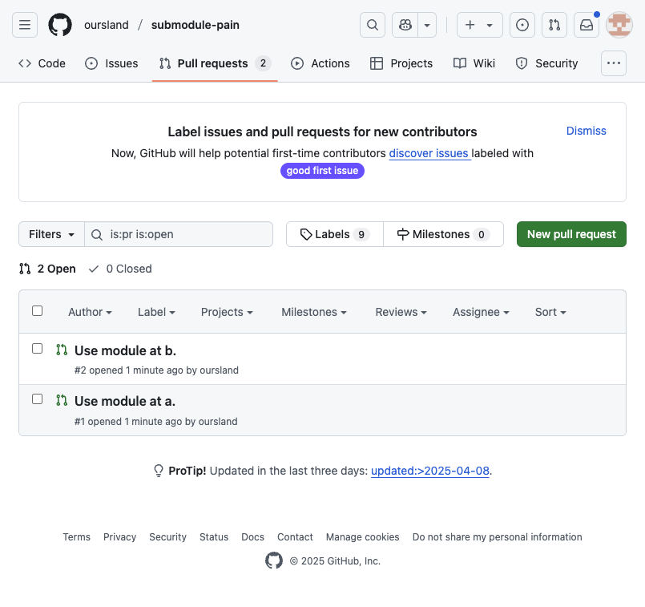
Top-level repo PRs

Slide 7
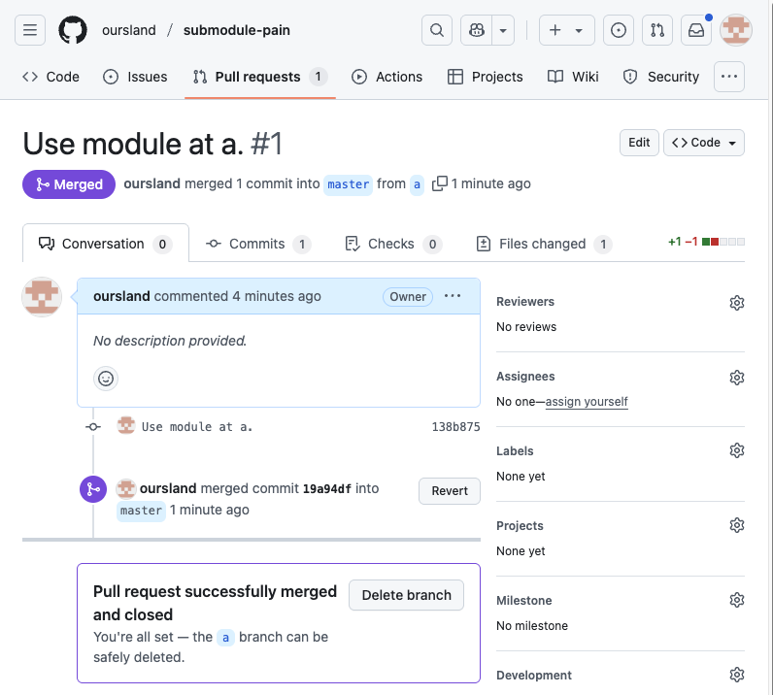
Merge ‘a’ into Top-Level Repo

Slide 8
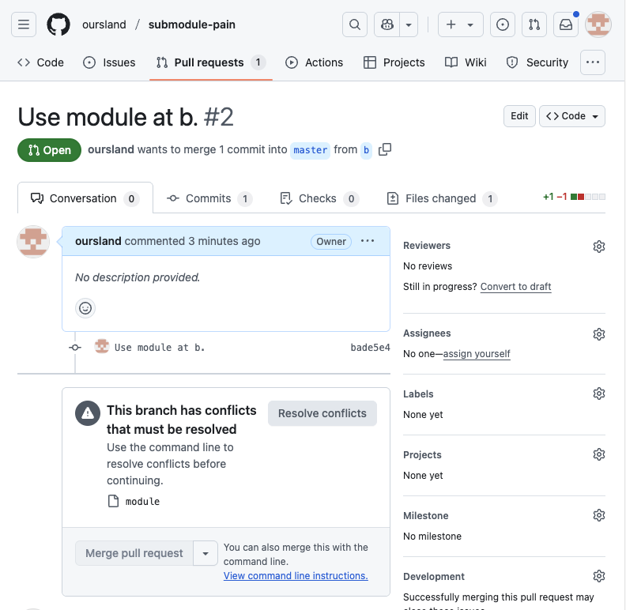
Now the the ‘b’ PR cannot merge due to ”conflicts”

Slide 9
Recap
No actual conflicts are present.
One PR added the file ‘a’ and the other added the file ‘b’, but because they are submodules git has no knowledge of the files or their compatibility.
Because each PR uses a different SHA, then the merge cannot take place because the conflict is in the SHA values.
PR#1: 81b3d609d3158822a6a37966436f5c64e1eb4ac6 -> c7c5d8c0d28bade1ba45706bf49d85df57771947
PR#2: 81b3d609d3158822a6a37966436f5c64e1eb4ac6 -> 75b743cf403b92c8f631d419490f04eef9832d1b

Slide 10
PRs Take Two: Default Branch Only
Okay, normally we do not want people to have submodules at branches which may not have been reviewed, but rather to only accept changes from:
tags
commits on default branch
commits on a release tracking branch
Let’s fix that with two new PRs
Based upon the current `master`, so ‘module’ now points to ‘a’
PR#3: adds the file ‘a’, but after being merged into ‘master’
PR#4: adds the file ‘b’, but after being merged into ’master’

Slide 11
PRs Take Two: Default Branch Only
oursland/submodule-pain-module
Adds the file ‘a’ after merging PR#1 into submodule
Adds the file ‘b’ after merging PR#2 (both ‘a’ and ‘b’ are present)
oursland/submodule-pain
PR#3: Branch ‘a2’ updates the submodule at branch ‘master’ after PR#1
c78ac2db2eb6ca7df9877249135affe0411cf853 module (heads/master)
PR#4: Branch ‘b2’ updates the submodule at branch ‘master’ after PR#2
5f015926eae1ba7100d6fb34c46b8e18b10ed5ec module (heads/master)

Slide 12
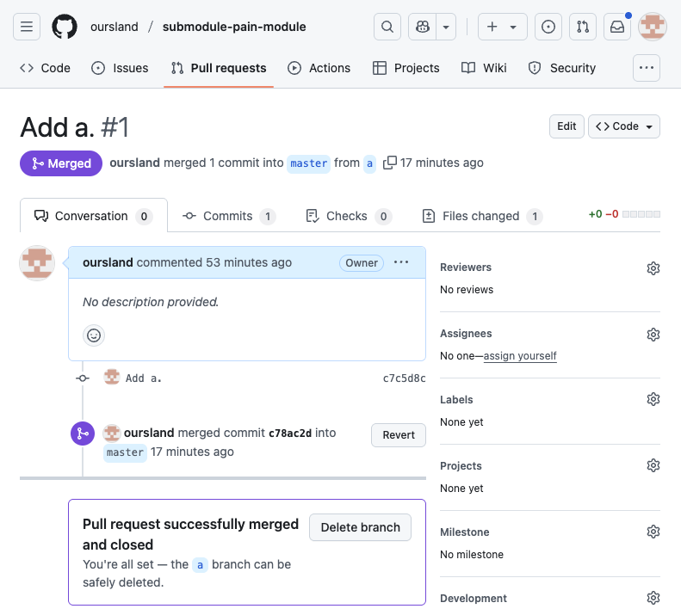
Merge PR#1 into Submodule

Slide 13
Create PR#3 in Top-Level Project
Submodule now has ‘a’ in the ‘master’ branch after code-review
Submit PR#3 with the updated submodule

Slide 14
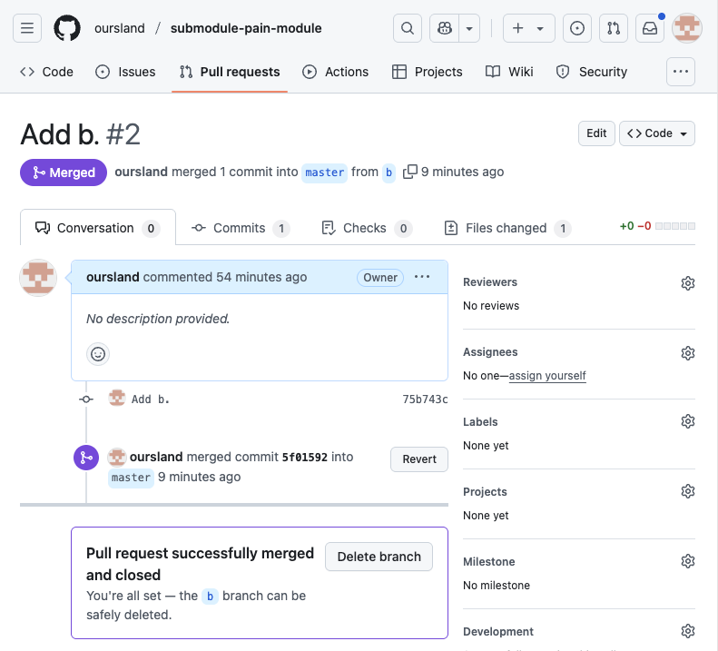
Merge PR#2 into Submodule

Slide 15
Create PR#4 in Top-Level Project
Submodule now has ‘b’ in the ‘master’ branch after code-review
Submodule now has both ‘a’ and ‘b’
Submit PR#4 with the updated submodule

Slide 16
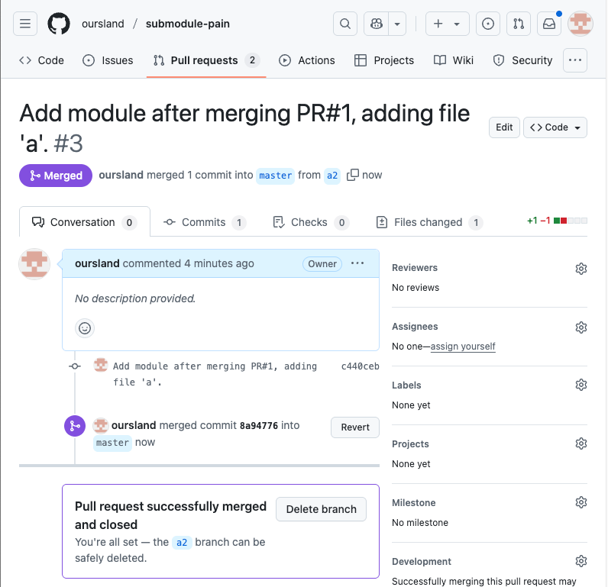
Merge PR#3 into Top-Level

Slide 17
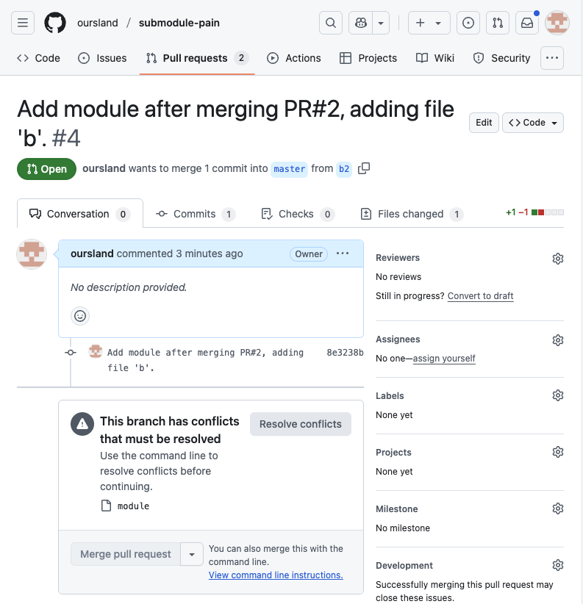
Cannot merge PR#4 due to “conflicts”

Slide 18
Again Conflicts
As before, git submodules do not track actual code changes and cannot perform merges
The submodule’s reference has changed in multiple PRs. After the first is merged, every following PR that touches that module will require manual resolution
Increasing the number of submodules increases the likelihood of these conflicts

Slide 19
How this affects FreeCAD
Proliferation of submodules increases the likelihood that a PR will cause a cascade of merge conflicts requiring manual resolution
Even simple changes like mosfet80’s frequent code cleanup PRs will invalidate every PR that takes place later in the chain
Merge Request Mondays could be brought to a halt
As davesrocketshop can attest to, weekly manual conflict resolution is no fun and does not push the project forward

Slide 20
How to Solve This?
Let git do what it is meant to do
Track source code in a line-oriented way, not SHAs
Perform automatic merges when changes do not conflict
Check in the source
Vendoring a release is an option, but it makes tracking local changes challenging and submitting patches upstream harder
Branches for vendored releases can be merged, which make managing the local repo easier, but still does not make submitting patches upstream any easier

Slide 21
How to Solve This? (cont.)
Check in the source (cont.)
Vendoring a remote repo is another option
Checkout a clone into the host repo (you can have multiple roots in a git repo!)
Use git read-tree to check-out the source at a given reference to a subdirectory
Use git filter-branch to reconstruct patches for submission upstream
git read-tree and git filter-branch are both arcane magick that should not be used casually. git filter-branch’s man page even comes with a massive warning.
Use git subtree

Slide 22
git Subtree
git subtree add --prefix=path/to/subdirectory/ repo-url branch-name
Will check out the repo at the desired branch and place it into the subdirectory.
This is done with a merge commit, preserving the history of the files.
Adding --squash will squash all commits to a single commit that is merged.
The merge commit’s message contains references to path of subtree, current repo when the subtree is added, and the remote repo when it was merged
Add 'src/Mod/Assembly/OndselSolver/' from commit '09d6175a2ba69e7016fcecc4f384946a2f84f92d’
git-subtree-dir: src/Mod/Assembly/OndselSolver
git-subtree-mainline: 5eb5af7068ac9e610ddbb3c62f6a5a54c7c3f818
git-subtree-split: 09d6175a2ba69e7016fcecc4f384946a2f84f92d

Slide 23
git Subtree Pulling in Upstream Changes
git subtree pull --prefix=path/to/subtree remote-repository branch-name
Will pull in changes from the upstream repo
The references in the prior merge commit are used to select which changes to bring
git subtree push --prefix=path/to/subtree remote-repository branch-name
Will push changes to the upstream repository
References in the prior merge commit are used to identify commits that are to be pushed upstream

Slide 24
Removing a git Subtree
Just run git rm –r path/to/subtree
The subtree is just normal code. The metadata is in the merge commit message.
Contrast that to the git submodule deletion
git submodule deinit -f -- path/to/submodule
rm -rf path/to/submodule
git rm -f path/to/submodule
Then commit
Note: switching branches which still have the submodule can cause problems

